Slide 1
Quantitative Research Report
By: Selam, Indeya, Mo, Colin, Kristina

Slide 2
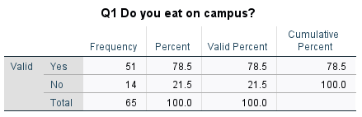
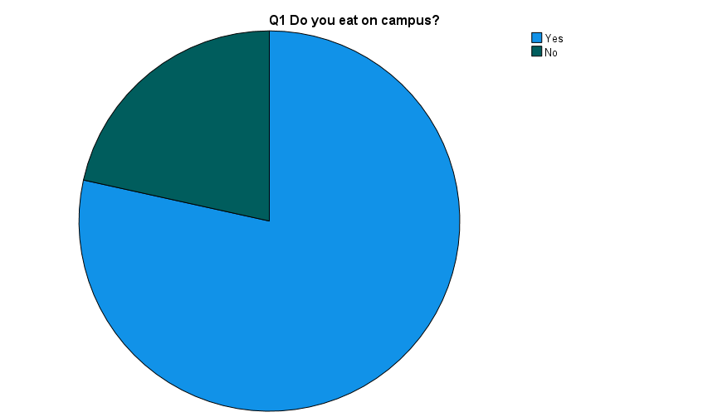
Interesting finding 1
Majority students do eat on campus
Blue represents 78.5% do eat on campus
Green represents the 21.5% do not eat on campus
Notes:
Indeya

Slide 3
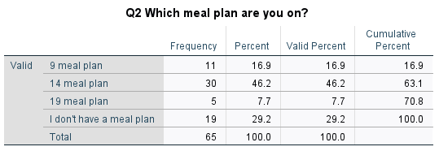
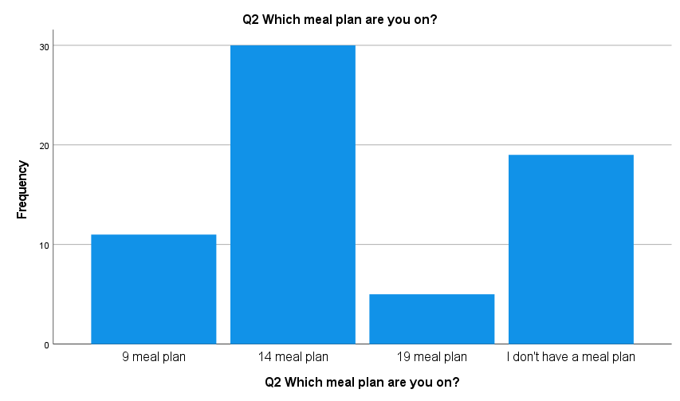
Interesting finding 1 continued…
The 14 meal plan is the most popular 46.2%
29.2% of the population does not have a meal plan
16.9% has a 9 meal plan
7.7% has a 19 meal plan

Slide 4
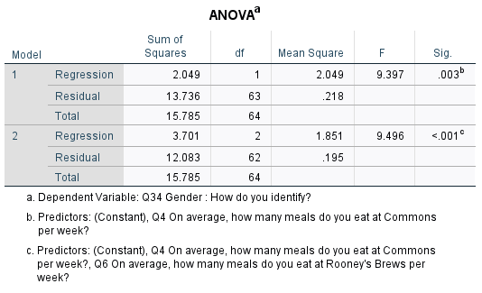
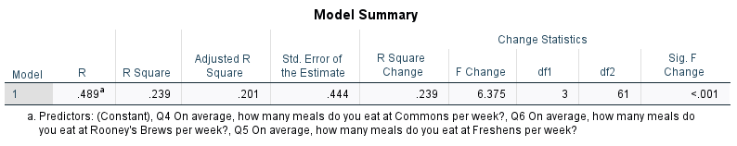
Interesting finding 2
Gender does have an influence on the
number of meals students eat on campus
Gender only accounts for 20.1% of the
difference.

Slide 5
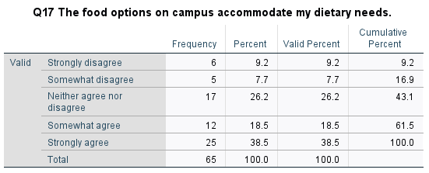
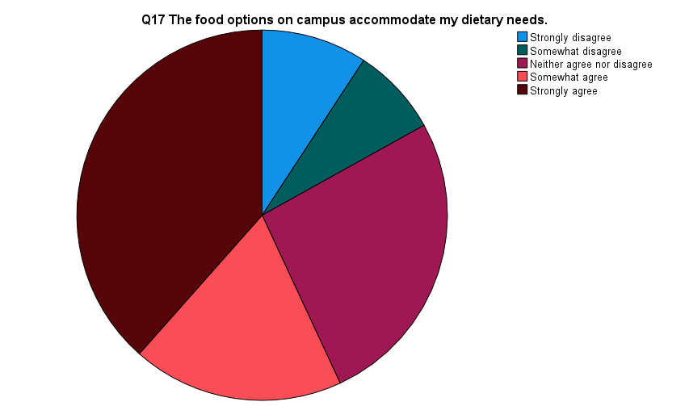
Interesting finding 3
Many dietary needs
Thousands of students
Notes:
There are many different types of dietary needs that are in the world. For ex. Gluten free, dairy free, sugar free, vegan, vegetarian, etc. The fact that the college is able to meet all these needs for the thousands of students that are on campus and eat on campus meals is impressive.
38.5% of students said they agree that the campus accommodates the needs students have when it comes to what they eat.

Slide 6
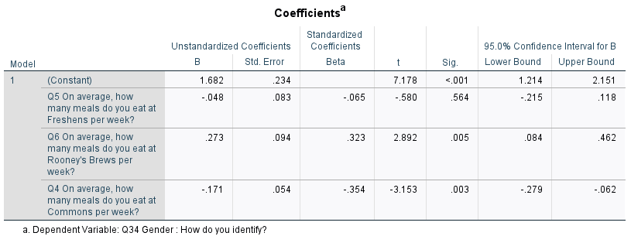
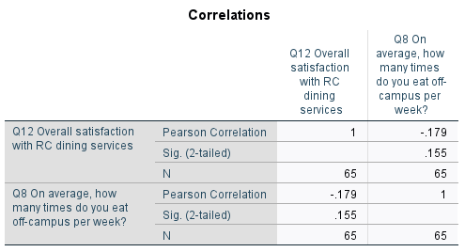
Conclusion
No Significant relationship! 65,65 for the total for correlations
-1.71 for people who at eat commons for a week

Slide 7
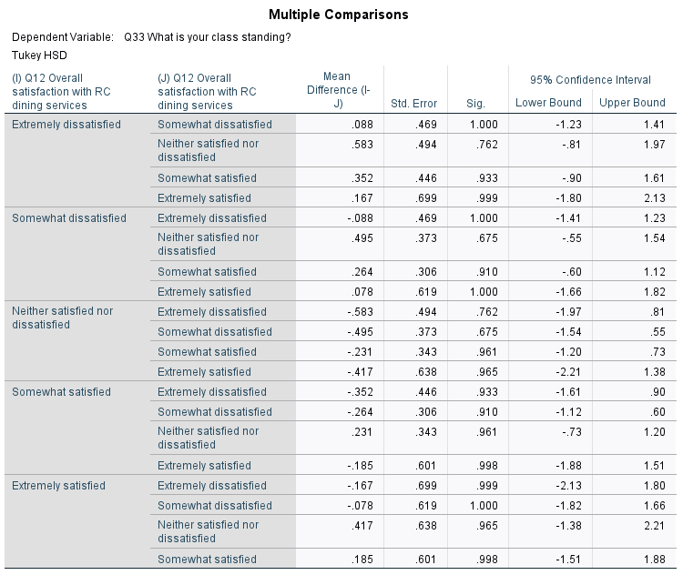
Conclusion continued…
Satisfaction rate for dining on campus.
.185 satisfaction for the food on campus

Slide 8
Recommendations
Conduct a student forum to get feedback of students wants/needs to accommodate them
Utilize the data findings to ensure student satisfaction (help with retention)
Offer more digital ordering and late night options
Fast food options (Chick-Fil-A)

